Slide 1
News Articles Sorting
DETAILED PROJECT REPORT

Slide 2
PROJECT DETAILS
PROJECT TITLE | News Articles Sorting
TECHNOLOGY | Deep Learning Technology (NLP)
DOMAIN | Media
PROJECT DIFFICULTY LEVEL | Intermediate
PROGRAMMING LANGUAGE USED | python
TOOLS USED | Jupyter notebook, MS-excel

Slide 3
OBJECTIVE
Nowadays on the Internet there are a lot of sources that generate immense amounts of daily news. In addition, the demand for information by users has been growing continuously, so it is crucial that the news is classified to allow users to access the information of interest quickly and effectively. This way, the machine learning model for automated news classification could be used to identify topics of untracked news and/or make individual suggestions based on the user’s prior interests.

Slide 4
PROBLEM STATEMENT
For a given news article, the system should be able to classify them according to various categories like Finance, Sports etc

Slide 5
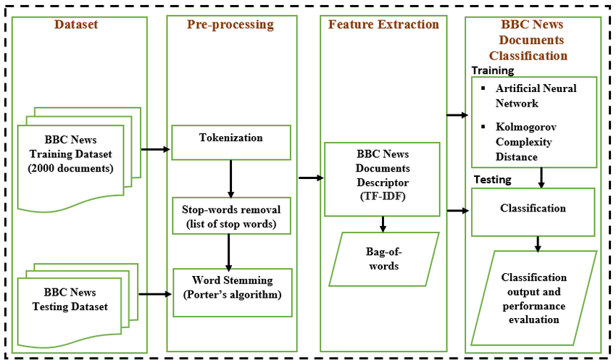
Architecture

Slide 6
DATASET INFORMATION
Article Id – Article id unique given to the record
Article – Text of the header and article
Category – Category of the article (tech, business, sport, entertainment, politics)

Slide 7
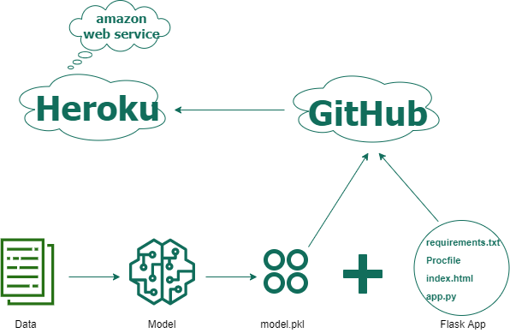
deployment

Slide 8
output
Here we are able to classify the news article into 5 Category –
Category of the article
tech,
business,
sport,
entertainment,
politics

Slide 9


